Slide 1
BrightStar Christian Academy
COVID-19 Health & Wellness Protocol
Last Updated 8/18/2021

Slide 2
BrightStar’s COVID-19 On-Campus Response
Since the start of shelter-in-place BCA has met and exceeded the CDC guidelines and CCLD Licensing standards for on-campus childcare. Thus far this has primarily pertained to the care we have provided for the children of frontline workers. As we shift into the Governor’s Phase II of loosening SIP guidelines, to now include more of the general public, we have further bolstered these protocols. Maintaining the health and wellness of both our staff and the children in our care is paramount. Here are some of the steps we have put in place to address risk of exposure and alleviate some of your concerns. Our goal is to decrease “social” distancing for our children, while keeping a safe “physical” distancing protocol.

Slide 3
Before The Day Begins
On a daily basis the entire BrightStar campus receives thorough professional deep cleaning

Slide 4
Before The Day Begins
All staff members’ temperatures are checked and if they have exhibited any of the symptoms of COVID-19 identified by the CDC, they are NOT allowed on campus.
Cough
Shortness of breath or difficulty breathing
Fever
Chills
Muscle pain
Sore throat
New loss of taste or smell
*Exposure to someone diagnosed with COVID-19

Slide 5
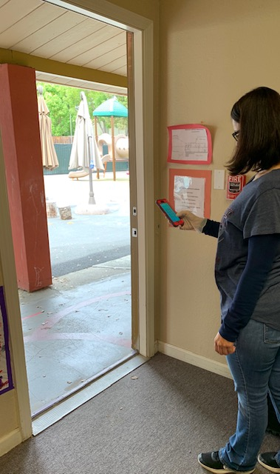
Before your child is admitted on-campus
BCA has implemented a contactless sign in and out process
Parents must wear a face covering and remain behind a boundary line and NOT enter the building
All children must immediately have their temperature checked
Children who exhibit any signs or symptoms of illness will also NOT be permitted on campus
Children who have been exposed to COVID -19 in their home will also NOT be permitted on campus
The teacher then inputs the child’s Kinderlime code and signs them in

Slide 6
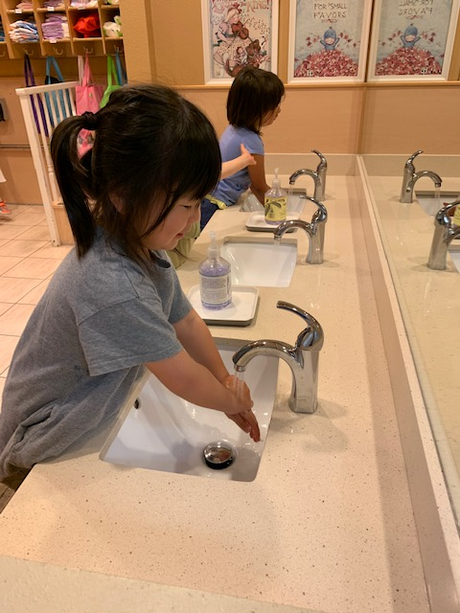
Once On Campus
Your child is then led to thoroughly wash their hands, using the CDC’s 20 second, soap and water protocol
This is continued throughout the day
Before and after the children enter new environments
Before they begin new activities
Before eating
When they finish using the restroom

Slide 7
While on Campus
Teachers are required to regularly follow the same hand washing protocols outlined by the CDC
Additionally, teachers are required to wear gloves and a mask while preparing or handling food
Staff have the option to wear gloves and a mask through out the day

Slide 8
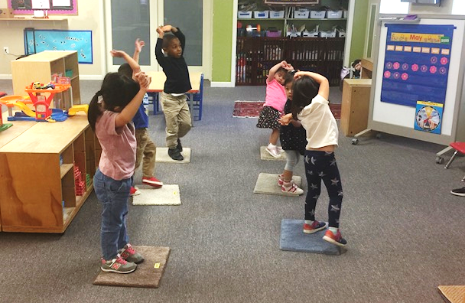
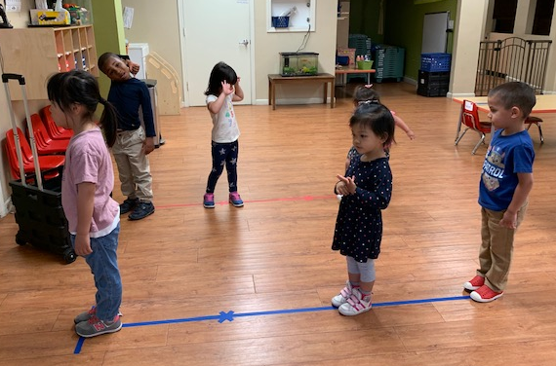
While On-campus
Children are able to engage in familiar activities with peers and loving teachers,
while maintaining safe physical distancing, and without sacrificing socialization

Slide 9
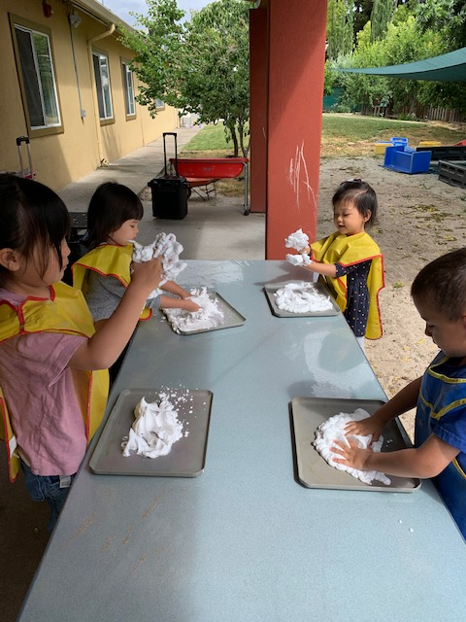
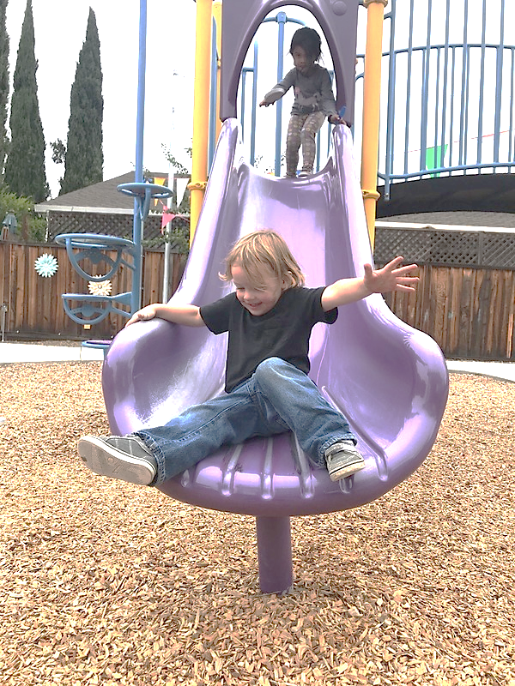
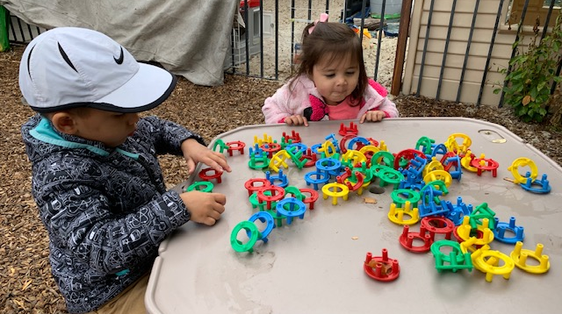
While On-campus
At BrightStar we actively implement an outdoor classroom philosophy. This means that your child will spend the majority their day in our
“open-air learning centers”

Slide 10
Additional steps BCA is taking to reduce risk
All child surfaces are rigorously and regularly disinfected
Contactless payment options have been implemented
Children are strictly shielded from members of the public

Slide 11
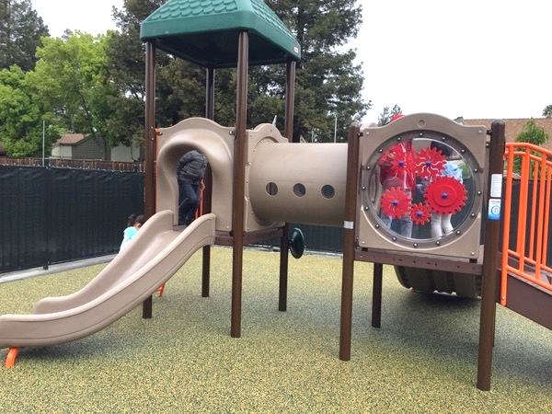
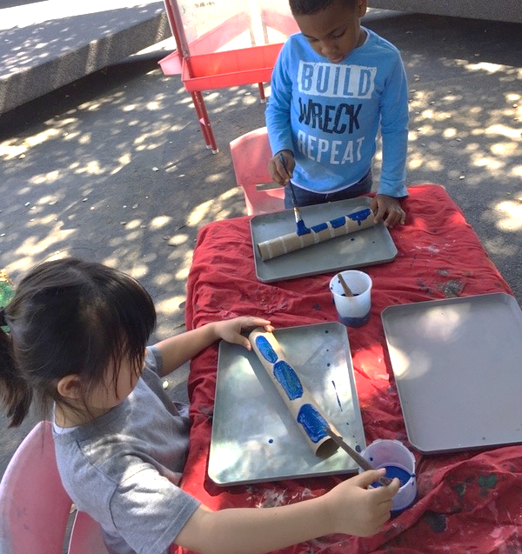
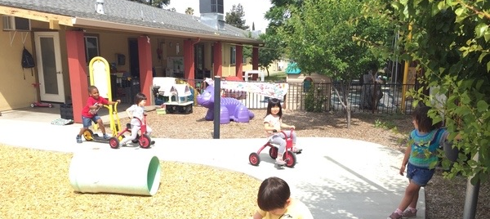
BrightStar’s COVID-19 On-Campus Response
At BrightStar we view caring for your children as a sacred and holy trust. This has been and will continue to be to be our vision long after the coronavirus is gone. We pray that this document encourages you and assures you that Brightstar will always be your partner in sharing God’s love with your children, while holding ourselves to the highest standard of care and safety.

Slide 12
BrightStar’s COVID-19 On-Campus Response
This remains an evolving document based on the current policies and procedures set by CCLD, the CDC and local government guidelines.
BCA Executive Director, Justin Fraser
mrjustin@mybrightstarca.com
BCA Admin Director, Jacqueline Alkhaseh
msjacqueline@mybrightstarca.com
408.266.7600

